Slide 1
DataBase

Slide 2
DataBase Design
Index

Slide 3


Slide 4
Indexing
many queries reference only small proportion of records / rows in file / table
inefficient for database system to read every tuple in relation, database system should be able to locate records directly
to allow these forms of access, to speed up queries, we design additional structures that we associate with tables

Slide 5
Indexing
index for a file in database system works in much the same way as index in a textbook
search for topic in index at the back of the book, find pages where it occurs, and then read pages to find information which we are looking
words in the index are in sorted order, making it easy to find the word we want; index is much smaller than the book, further reducing effort

Slide 6
two basic kinds of indexes
Ordered indexes - based on a sorted ordering of the values
Hash indexes - based on a uniform distribution of values across a range of buckets; the bucket to which a value is assigned is determined by a hash function

Slide 7
Search key
often want to have more than one index for a file
for example, we may wish to search for book by author, by subject, or by title
attribute or set of attributes used to look up records in a file is called search key; definition of key differs from that used in primary key, candidate key, and superkey -
if there are several indexes on a file, there are several search keys

Slide 8
Ordered indexes
stores values of search keys in sorted order and associates with each search key the records that contain it
if file containing records is sequentially ordered, a clustering index is an index whose search key also defines the sequential order of file
clustering indexes are also called primary indexes; the term primary index may appear to denote index on primary key, but such indexes can in fact be built on any search key - search key of clustering index is often the primary key, although that is not necessarily so
indexes whose search key specifies an order different from sequential order of the file are called non-clustering indexes, or secondary indexes
files with clustering index are called index-sequential files

Slide 9
index entry, or index record, consists of a search-key value and pointers to one or more records with that value as their search-key value
pointer to record consists of identifier of a disk block and an offset within disk block to identify record within block

Slide 10
Dense and Sparse indexes
dense index - index entry appears for every search-key value in file
  dense clustering index, index record contains search-key value and pointer to first data record with that search-key value; rest of the records with same search-key value would be stored sequentially after
  dense non-clustering index, index must store a list of pointers to all records with same search-key value
sparse index - index entry appears for only some of search-key values; can be used only if relation is stored in sorted order of earch key; that is, if the index is a clustering index

Slide 11
Dense index
Sparse in

Slide 12
search-key value is not a primary key
dense clustering index for search key being dept_name

Slide 13
generally faster to locate a record if we have dense index rather than sparse index
sparse indexes have advantages over dense indexes in that they require less space and they impose less maintenance overhead for insertions and deletions

Slide 14
if index is small enough to be kept entirely in main memory, search time to find an entry is low
if index is so large that not all of it can be kept in memory, index blocks must be fetched from disk when required
it may not be possible to keep entire index in memory - search for an entry in index then requires several disk-block reads
to deal with this problem, we treat index just as we would treat any other sequential file, and we construct sparse outer index on original index, which we now call the inner index

Slide 15
Two-level sparse index

Slide 16
multilevel indexes
indexes with two or more levels are called multilevel
searching for records with multilevel index requires significantly fewer I/O operations than does searching for records by binary search
multilevel indexes are closely related to tree structures

Slide 17
Index Update

Slide 18
Secondary indexes
must be dense, with index entry for every search-key value, and pointer to every record in file
clustering index may be sparse, storing only some of search-key values, since it is always possible to find records with intermediate search-key values by sequential access to part of file
if secondary index stores only some of search-key values, records with intermediate search-key values may be anywhere in the file

Slide 19
Secondary Index

Slide 20
indexes on Multiple Keys
search key containing more than one attribute is referred to as a composite search key
search key can be represented as a tuple of values, of the form (a₁,..., a_{n}), where the indexed attributes are A₁,..., A_{n}
ordering of search-key values is the lexicographic ordering, basically, same as alphabetic ordering of words

Slide 21
main disadvantage of the index-sequential file organization is that performance degrades as file grows, both for index lookups and for sequential scans through the data - degradation can be remedied by reorganization of the file - frequent reorganizations are undesirable

Slide 22
B-Tree

Slide 23
B-tree
is a self-balancing tree data structure that maintains sorted data and allows searches, sequential access, insertions, and deletions in logarithmic time
generalizes the binary search tree, allowing nodes to have more than two children
reduces the height of the tree and puts the data in fewer separate blocks
used in databases and file systems

Slide 24
B⁺-tree index
B⁺-tree index structure is the most widely used of several index structures that maintain their efficiency despite insertion and deletion of data
B⁺-tree index takes the form of a balanced tree in which every path from the root of the tree to a leaf of the tree is of the same length; each non leaf node in tree, other than root, has between ⌈n/2⌉ and n children, where n is fixed for a particular tree; the root has between 2 and n children
imposes performance overhead on insertion and deletion and adds space overhead - overhead is acceptable even for frequently modified files, since the cost of file reorganization is avoided

Slide 25
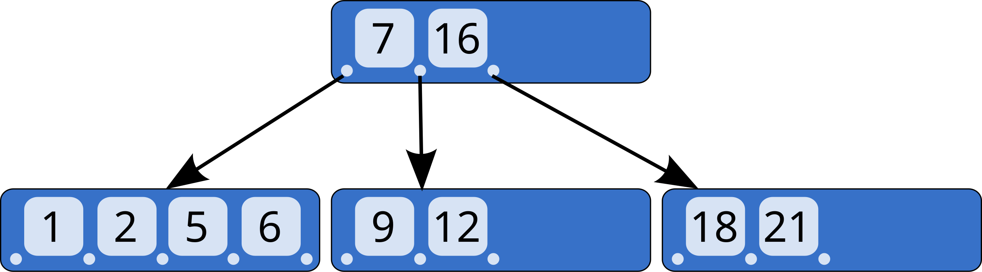
B-tree of order 5 (Knuth 1998).

Slide 26
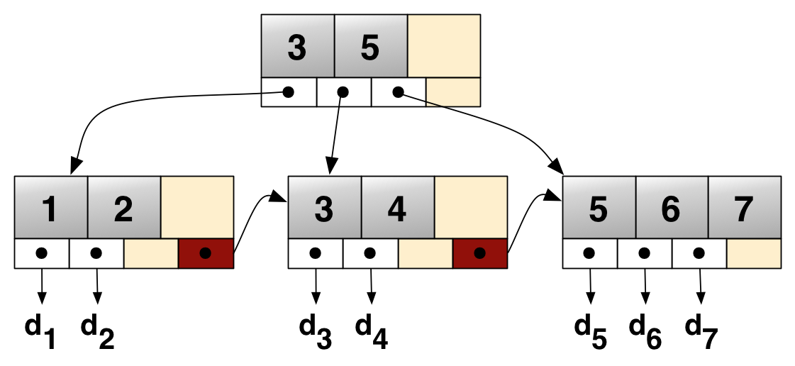
B⁺ tree example linking keys 1–7 to data values d1-d7 linked list (red) allows rapid in-order traversal tree's branching factor is b = 4 both keys in leaf and internal nodes are colored gray

Slide 27
assume for now that there are no duplicate search key values
typical node of a B⁺-tree contains up to n − 1 search-key values K₁, K₂,..., K_{n−1}, and n pointers P₁, P₂,..., P_{n}
search-key values within node are kept in sorted order; thus, if i < j, then K_{i} < K_{j}
for i = 1,2,..., n − 1, pointer P_{i} points to a file record with search-key value K_{i} ; pointer P_{n} has special purpose

Slide 29
each leaf can hold up to n − 1 values
allow leaf nodes to contain as few as ⌈(n −1)/2⌉ values
with n = 4 in our example B⁺-tree, each leaf must contain at least two values, and at most three values
use P_{n} to chain together the leaf nodes in search-key order; ordering allows for efficient sequential processing of file
non-leaf nodes form a multilevel (sparse) index on leaf nodes
structure of non-leaf nodes is the same as that for leaf nodes, except that all pointers are pointers to tree nodes
non-leaf nodes are also referred to as internal nodes

Slide 31
B⁺-tree for instructor file (n = 4)
another B⁺-tree for instructor file (n = 6)

Slide 32
B⁺-trees are all balanced – length of every path from root to leaf node is the same - requirement for B⁺-tree - the “B” in B⁺-tree stands for “Balanced”
balance property of B⁺-trees ensures good performance for lookup, insertion, and deletion

Slide 33
most database implementations make search keys unique as follows:
desired search key attribute a_{i} of relation r is nonunique; let A_{p} be the primary key of r - then unique composite search key (a_{i}, A_{p}) is used instead of a_{i} when building the index

Slide 34
Queries on B⁺-Trees
range queries

Slide 35
Updates on B⁺-Trees

Slide 36
B-Tree Index Files
are similar to B⁺-tree indexes, distinction between the two approaches is that a B-tree eliminates the redundant storage of search-key values

Slide 37
Hash

Slide 38
Hashing algorithms are mathematical functions that convert data of any size into a fixed-length string of characters (a hash or digest) in a one-way, irreversible process, used to verify data integrity, secure passwords, and efficiently store/retrieve data in hash tables
must be fast, deterministic (same input always yields same output), and collision-resistant (different inputs rarely yield the same output), exhibiting the "avalanche effect" where tiny input changes drastically alter the output

Slide 39
Hash indexes
Hashing is a widely used technique for building indexes; such indexes may be transiently created to process join operation or may be permanent structure
Hashing has also been used as a way of organizing records in file

Slide 40
bucket
unit of storage that can store records
a linked list of disk blocks
in hash file organization, instead of record pointers, buckets store the actual records; such structures only make sense with disk-resident data

Slide 41
hash function
let K denote set of all search-key values
let B denote set of all bucket addresses
let h denote a hash function - hash function h is function from K to B
to insert record with search key K_{i}, we compute h(K_{i}), which gives the address of bucket for that record
hash indexes efficiently support equality queries on search keys
unlike B⁺-tree indexes, hash indexes do not support range queries

Slide 42
Bitmap

Slide 43
Bitmap indexes
bitmap indexes are a specialized type of index designed for easy querying on multiple keys, although each bitmap index is built on a single key

Slide 44
for bitmap indexes to be used, records in relation must be numbered sequentially - given a number n, it must be easy to retrieve record numbered n - achieved when records are fixed in size and allocated on consecutive blocks of file

Slide 45
consider relation instructor, which has (in addition to ID attribute) an attribute
gender, which can take on only one of a small number (e.g., 2 to 20) of values (male) or (female)
income_level, which which can take on only one of a small number (e.g., 2 to 20) of values broken up into five levels: L1: 0 - 9999, L2: 10,000 - 19, 999, L3: 20,000 - 39, 999, L4: 40,000 - 74, 999, and L5: 75,000 - ∞
  raw data can take on many values, but data analyst has split the values into a small number of ranges to simplify analysis of the data

Slide 46
Bitmap indexes on relation instructor_info.

Slide 47
bitmap - an array of bits
bitmap index - on attribute A of relation r consists of one bitmap for each value that A can take
each bitmap has as many bits as the number of records in relation
the i^{th} bit of bitmap for value v_{j} is set to 1 if record numbered i has the value v_{j} for attribute A; all other bits of the bitmap are set to 0

Slide 48
simplest way of retrieving all records with value m (or value f) would be to simply read all records of relation and select those records with value m (or f, respectively)
bitmap index doesn’t really help to speed up such a selection
bitmap indexes are useful for selections mainly when there are selections on multiple keys
query that selects women with income in range 10,000 to 19,999
select *
from instructor_info
where gender = 'f and income_level = 'L2';

Slide 49
fetch bitmaps for gender value f and bitmap for income_level value L2, and perform intersection (logical and) of two bitmaps

Slide 50
Index of Spatial and Temporal Data

Slide 51
traditional index structures, such as hash indexes and B⁺-trees, are not suitable for indexing of spatial data, which are typically of two or more dimensions
when tuples have temporal intervals associated with them, and queries may specify time points or time intervals, the traditional index structures may result in poor performance

Slide 52
spatial data
query that asks for cârciumă at a precisely specified (latitude, longitude) pair can be answered by creating B⁺-tree on composite attribute (latitude, longitude)
B⁺-tree index cannot efficiently answer query that asks for all cârciumă that are within a 500-meter radius of a user’s location, which is identified by a (latitude, longitude) pair or are within a region of interest
range queries an example of a nearest neighbor query

Slide 53
temporal data
refers to data that has an associated time period, valid time interval
a time interval has a start time and an end time; interval is open or closed at start / end time
to represent the fact that tuple is valid currently, until it is next updated, the end time is conceptually set to infinity (which can be represented by a suitably large time, such as midnight of 9999-12-31)
any valid period can be represented by multiple intervals

Slide 54
CREATE INDEX

Slide 55
most databases support SQL commands to create and drop indexes
create index <index-name> on <relation-name> (<attribute-list>);
attribute-list is the list of attributes of relation that form the search key for index
indexes can be dropped using
drop index <index-name>;
to declare that attribute or set of attributes is candidate key, use syntax
create unique index in place of create index above

Slide 56
when user submits SQL query that can benefit from using an index, the SQL query processor automatically uses the index
indexes can be very useful on attributes that participate in selection conditions or join conditions of queries, since they can reduce the cost of queries significantly Bitmap indexes

Slide 57
what index are needed
to determine which indexes are needed for a database, you must evaluate your query patterns and data integrity requirements

Slide 58
Primary Key Index: essential for every table to uniquely identify records; it is typically created automatically by the database system
Unique Index: required on columns that must contain unique values (e.g., email addresses or names) to prevent duplicate entries and maintain data integrity
Secondary Indexes: needed for any columns frequently used in WHERE clauses, JOIN conditions, or search criteria to speed up data retrieval
Composite Index: necessary when queries regularly filter or sort by multiple columns simultaneously (e.g., searching by both Last_Name and First_Name)

Slide 59
Full-Text Index: required for performing advanced word searches within large character string data or text-heavy columns
Spatial Index: for applications dealing with geographic or geometric data types to perform spatial operations efficiently
Hash Index: suited for equality comparisons (e.g., column = 'value') rather than range searches, providing high-speed lookups in specific data structures
Columnstore Index: primarily used in data warehousing environments to optimize performance of analytical queries on massive datasets.

Slide 60
Best Practices for Index Selection
Usefulness Rule: only create index if it significantly speeds up specific queries, as every additional index slows down write operations
Clustering: aim to group records that are likely to be accessed together to minimize physical disk I/O
Avoid Over-Indexing: large numbers of indexes (more then 5 maybe …) can lead to performance degradation during data modification; prioritize indexes that cover the most frequent or critical queries

Slide 61
PostGreSQL

Slide 62
Indexes
B-Tree
BRIN
GiST
GIN
hash

Slide 63
Index B-Tree
is a general-purpose index common in relational databases
can usually get by with B-Tree alone if you don’t want to experiment
if PostgreSQL automatically creates an index or don’t bother specifying index method, B-Tree will be chosen method
only indexing method for Primary Keys and Unique keys

Slide 64
Index BRIN
Block Range INdex (BRIN) designed specifically for very large tables where using index such as B-Tree would take up too much space and not fit in memory
approach of BRIN is to treat a range of pages as one unit
BRIN indexes are much smaller than B-Tree and other indexes and faster to build; but they are slower to use and can’t be used for certain situations

Slide 65
Index GiST
Generalized Search Tree (GiST) index optimized for FTS, spatial data, scientific data, unstructured data and hierarchical data
lossy index, in the sense that will not store the value of what it’s indexing, but merely a bounding value such as box for a polygon
  this creates the need for an extra lookup step if you need to retrieve the value or do a more fine-tuned check

Slide 66
Index GIN
Generalized Inverted Index (GIN) geared toward built-in full text search and binary JSON
descendent of GiST but without the lossiness
will clone values in columns that are part of index
GIN is faster than GiST; larger and updating is slower
can’t use GIN to index large objects

Slide 67
Index hash
were popular prior to advent of GiST and GIN
general consensus rates GiST and GIN above hash in terms of both performance and transaction safety
hash indexes were relegated to legacy status
gained transactional safety and some performance improvements that made them more efficient than B-Tree in some cases

Slide 68
Partial Indexes
MultiColumn Indexes

Slide 69
DBeaver with PostGreSQL northwind

Slide 70
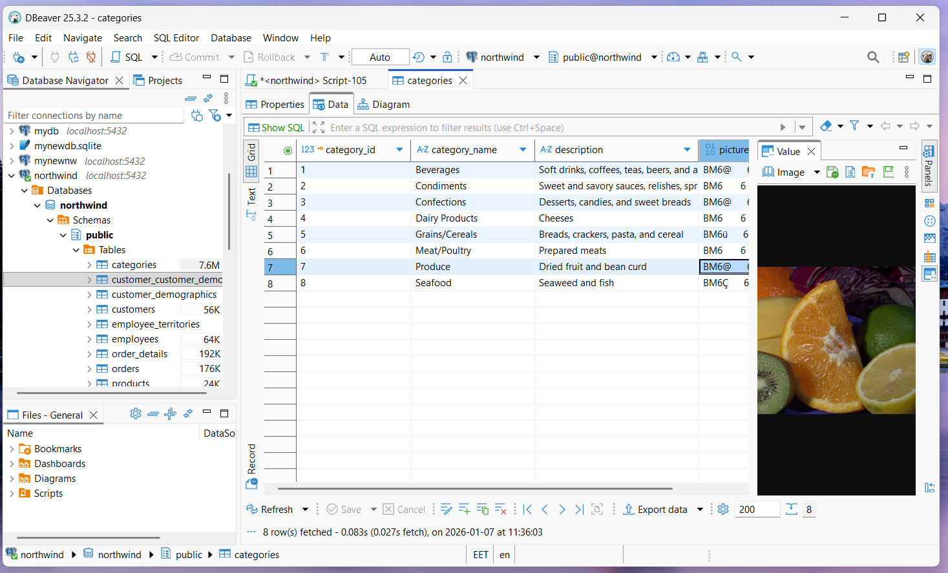

Slide 71
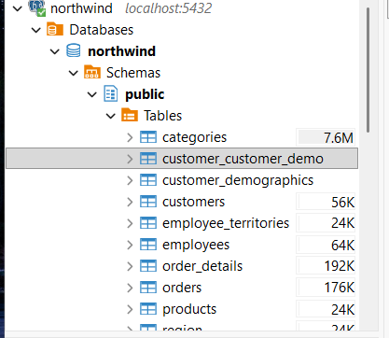
images in categories table makes the storage larger (Mbits …) instead of (Kbits …)
tries to estimate total size
  table
  index
  …

Slide 72
select pg_relation_size('products');
8.192 (bytes)
select pg_relation_size('employees');
8.192 (bytes)
select pg_relation_size('customers');
16.384 (bytes)
select pg_relation_size('categories');
8.192 (bytes)

Slide 73
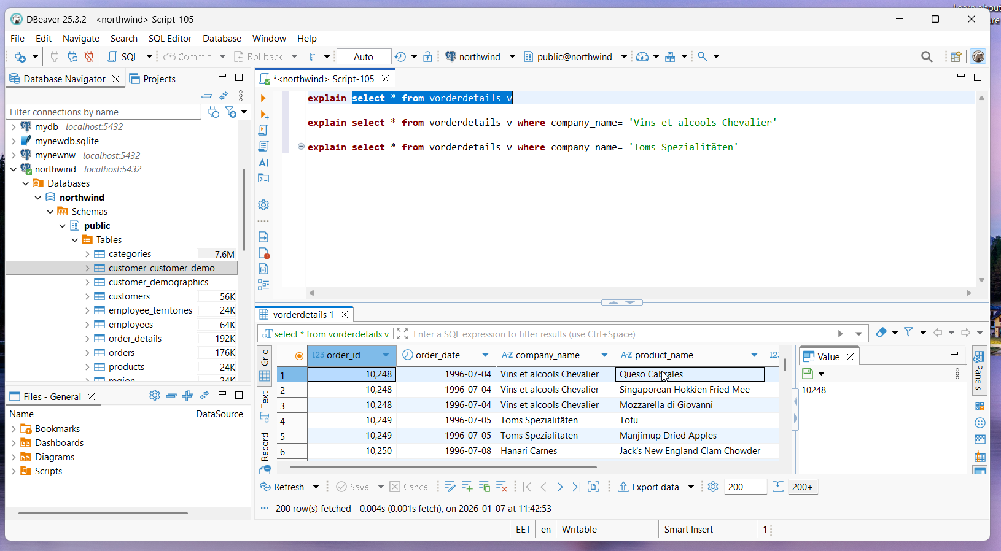

Slide 74
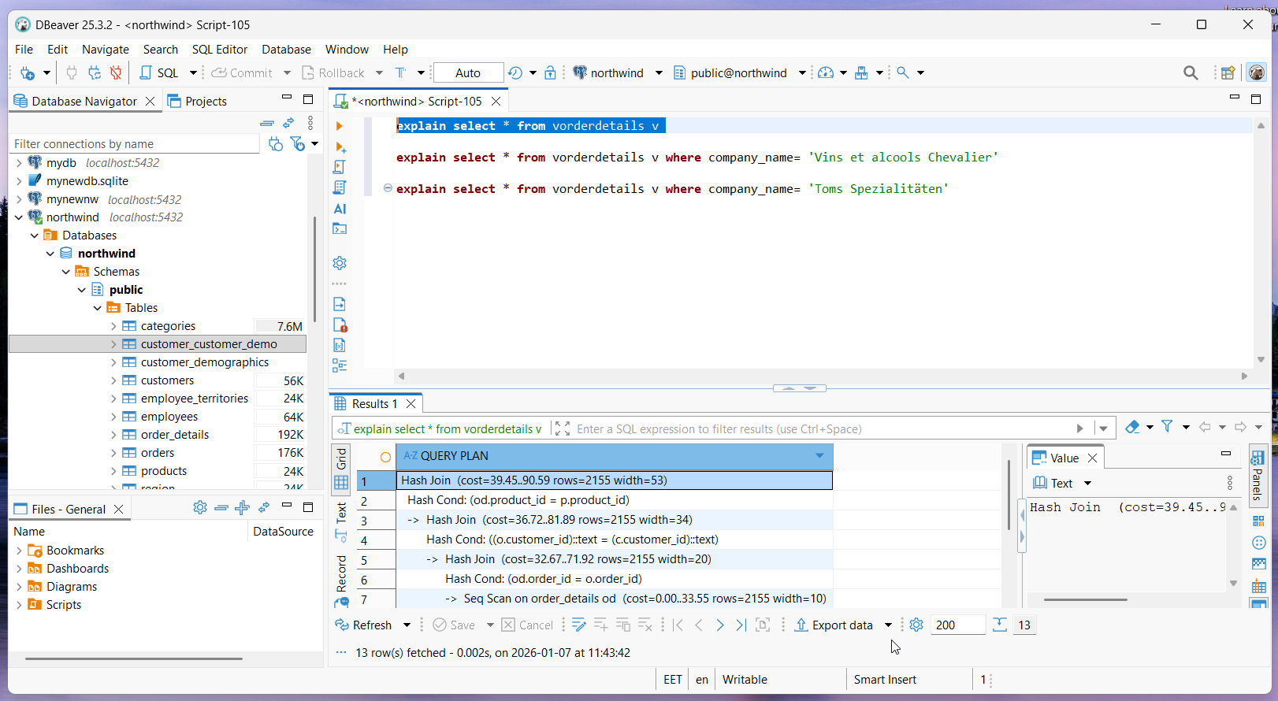

Slide 75
cost
select * from vorderdetails v
(cost=39.45..90.59 rows=2155 width=53)
select * from vorderdetails v where company_name= 'Vins et alcools Chevalier'
(cost=6.16..34.65 rows=23 width=53)
select * from vorderdetails v where company_name= 'Toms Spezialitäten'
(cost=6.16..34.65 rows=23 width=53)

Slide 76
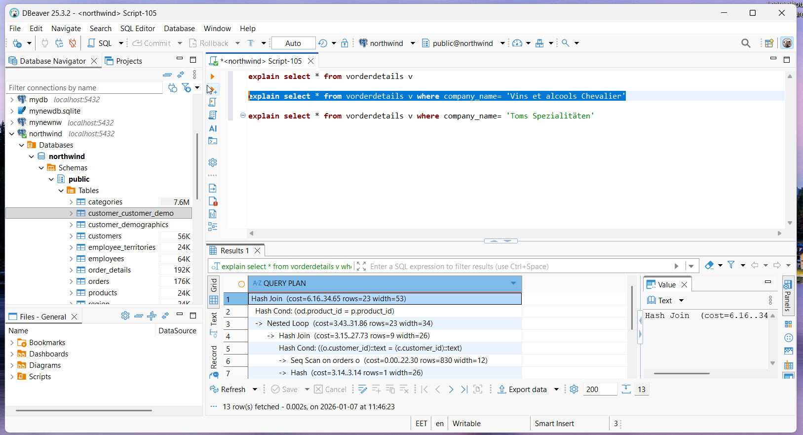

Slide 77
Query Plan
Hash Join (cost=6.16..34.65 rows=23 width=53)
Hash Cond: (od.product_id = p.product_id)
-> Nested Loop (cost=3.43..31.86 rows=23 width=34)
-> Hash Join (cost=3.15..27.73 rows=9 width=26)
Hash Cond: ((o.customer_id)::text = (c.customer_id)::text)
-> Seq Scan on orders o (cost=0.00..22.30 rows=830 width=12)
-> Hash (cost=3.14..3.14 rows=1 width=26)
-> Seq Scan on customers c (cost=0.00..3.14 rows=1 width=26)
Filter: ((company_name)::text = 'Vins et alcools Chevalier'::text)
-> Index Scan using pk_order_details on order_details od (cost=0.28..0.43 rows=3 width=10)
Index Cond: (order_id = o.order_id)
-> Hash (cost=1.77..1.77 rows=77 width=23)
-> Seq Scan on products p (cost=0.00..1.77 rows=77 width=23)

Slide 78
explain analyze select * from vorderdetails v
Hash Join (cost=39.45..90.59 rows=2155 width=53) (actual time=0.350..2.181 rows=2155.00 loops=1)
explain analyze select * from vorderdetails v where company_name= 'Vins et alcools Chevalier'
Hash Join (cost=6.16..34.65 rows=23 width=53) (actual time=0.089..0.307 rows=10.00 loops=1)
explain analyze select * from vorderdetails v where company_name= 'Toms Spezialitäten'
Hash Join (cost=6.16..34.65 rows=23 width=53) (actual time=0.068..0.287 rows=14.00 loops=1)

Slide 79
Thank you! very much for your kind attention!

Slide 80
Hope that you have at least half as much pleasure reading this as I had writing it!

Slide 81
Exam advice:
The famous Henry Ford quote is: "Whether you think you can, or you think you can't—you're right!"

Slide 82
Whish you
The famous Henry Ford quote is: "Whether you think you can, or you think you can't—you're right!"

Slide 83
If I should stay
I would only be in your way
So I'll go, …
Bittersweet memories
That is all I'm taking with me
So goodbye, …
I hope life treats you kind
And I hope you have all you've dreamed of
And I wish to you joy and happiness
But above all this, I wish you love

Slide 84
Whitney Houston

